Slide 1
How to get a library eBook on an HTC Android Phone
Step-by-Step Guide
Prepared by the Computer Lab
Montgomery County-Norristown Public Library
Sept 2014

Slide 2
The following screenshots were made using an HTC One M8 running the KitKat version of the OS. Your phone may differ. This is meant as a general guide. Be aware that the latest version of OverDrive requires at least Android 4.0 installed on your device. To make sure you have the latest system updates, please refer to your device’s manual. If you have an older Android device that cannot be upgraded, you will still be able to get OverDrive, but it will be version 2.2 and will function differently than in this tutorial.

Slide 3
Overview of Basic Steps
Download the OverDrive App to your phone.
Sign up for an OverDrive account
Use the OverDrive app to search library digital collection and check out a book
Use OverDrive to read and manage your eBooks

Slide 4
What do I need to get started?
You will need:
A library card based on a residency in Montgomery County
Access to the Internet either through your providers data network, or through a Wi-Fi access point
A valid email address to create an OverDrive account
Your Android phone with Google Play Store installed

Slide 5
Policies and tips to bear in mind when borrowing eBooks…
Valid Montgomery County library card
Borrowing period- 7, 14 or 21 days
Borrowing limits-10 items at one time (audio and eBooks combined)
Renewable –There is a renew feature which allows you to place advance holds on titles that you currently have checked out. This feature is available three days prior to expiration of your title. You need to do this proactively. You will not be prompted.
Reserving – limited to 10 items at one time (audio and eBooks combined)
Pick up a reserve book within 72 hours of email notification
Late Fees – None!
“Shopping” cart – lasts only 30 minutes!

Slide 6
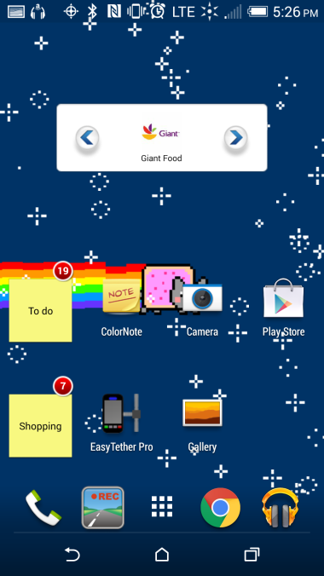
Getting the OverDrive App
We need to find the Play Store app in order to search for the OverDrive app to download.
Your phone may have it right on the homepage.
If it isn’t, tap on the apps directory button on your phone to search for it.

Slide 7
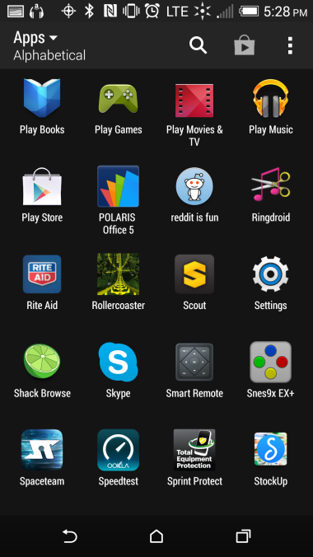
Getting the OverDrive App
Scroll until you find the Play Store app and tap on it.

Slide 8
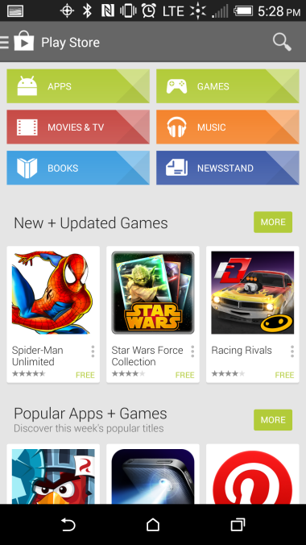
Getting the OverDrive App
The Google Play Store app loads. Tap on the magnifying glass in the upper right to start a search.

Slide 9
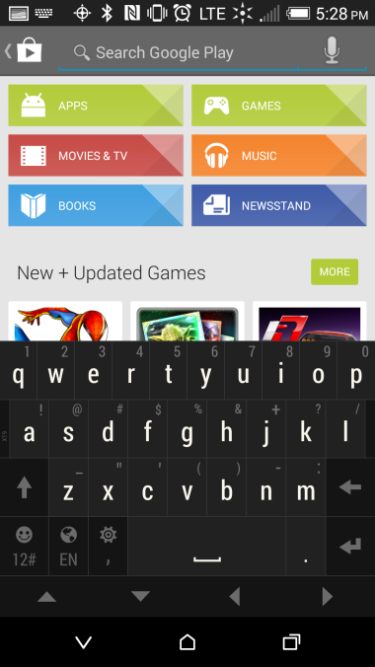
Getting the OverDrive App
Type “OverDrive” and, on your keypad, hit enter key to see list of results.

Slide 10
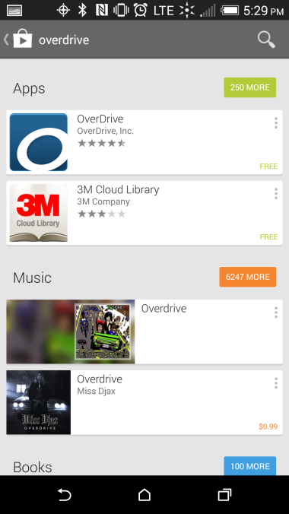
Getting the OverDrive App
This shows the list view of your search results.
OverDrive should be the first app listed in the search results. Make sure it is made by “OverDrive, Inc”. It is a free app and does not require a credit card to download.
Tap on the item in the search results.

Slide 11
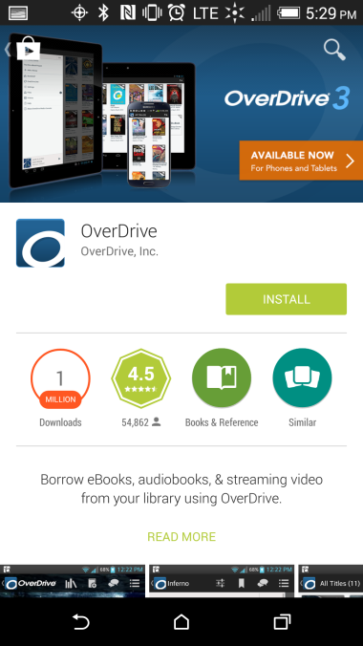
Getting the OverDrive App
Tap on the Install button.

Slide 12
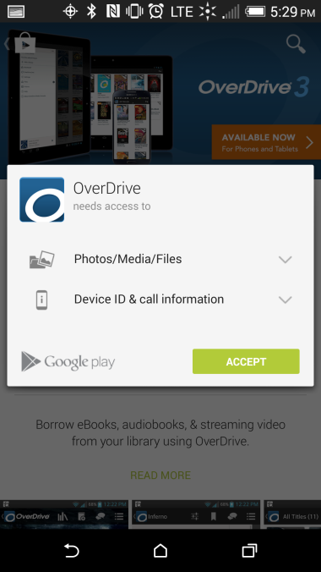
Getting the OverDrive App
The app asks for some standard access permissions so you can enjoy eBooks and audiobooks on your device.
Tap on the Accept button

Slide 13
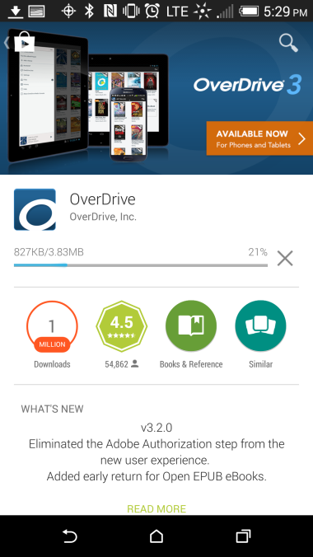
Getting the OverDrive App
The app will begin downloading and will install automatically.

Slide 14
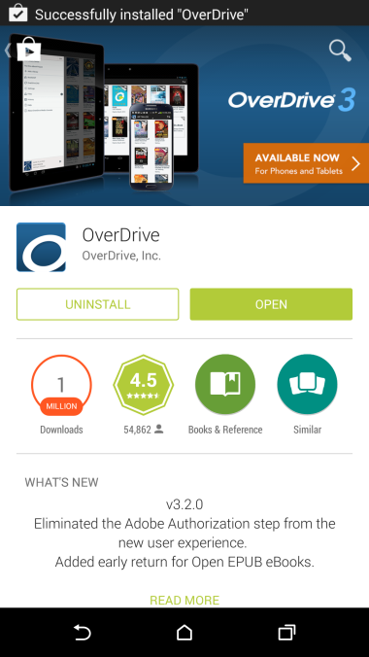
Getting the OverDrive App
Once OverDrive has been downloaded and installed, you will see an “open” button displayed along with an “uninstall” button.
Tap on the “open” button to start the app.

Slide 15
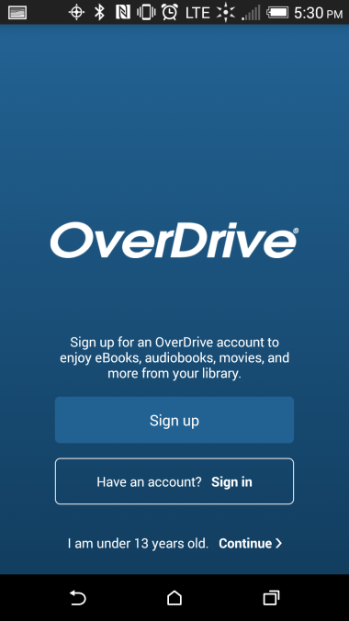
Getting started with the
OverDrive App
If this is the first time you are downloading the app, you will be required to sign up for an OverDrive account, or login with a current one.
Click the Sign up button if this is the first time using this app.

Slide 16
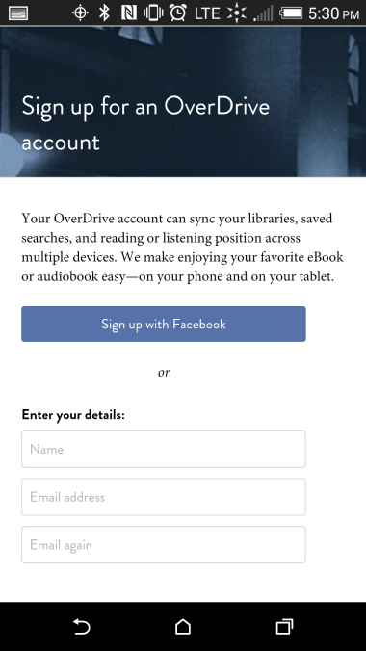
Getting started with the
OverDrive App
If you have a Facebook account, you can easily use that to sign up with OverDrive. It will automatically link with Facebook so you can use your same login credentials.
Otherwise you can sign up by entering your email address and a password. Scroll down the screen to see more.

Slide 17
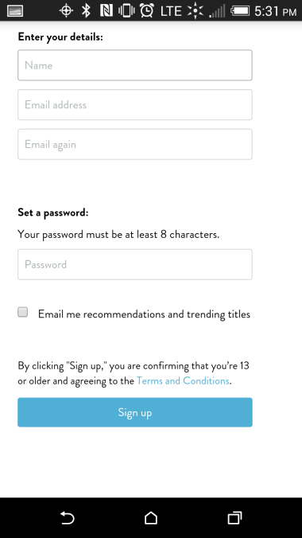
Getting started with the
OverDrive App
There is only one password field, so make sure you take your time and enter your password correctly. After you are done, tap the “Sign up” button.
You will automatically be signed in to the app, and will not be required to do so again, unless you need to login on another device

Slide 18
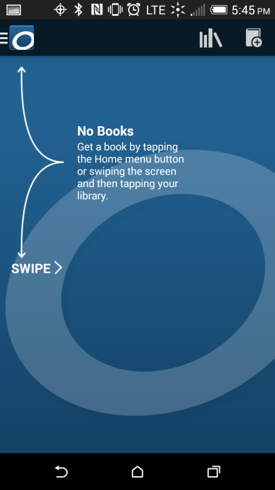
Getting started with the
OverDrive App
This is the home screen of the OverDrive app.
When you finally add some books in your bookshelf, the last read book will show here instead.
Tap on the Menu button or swipe the screen as instructed.

Slide 19
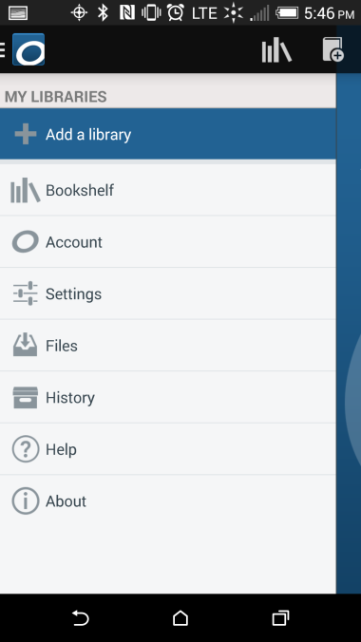
Using the OverDrive App
Getting started with the
OverDrive App
You will need to tell OverDrive which library you belong to.
Tap on the Add a Library button

Slide 20
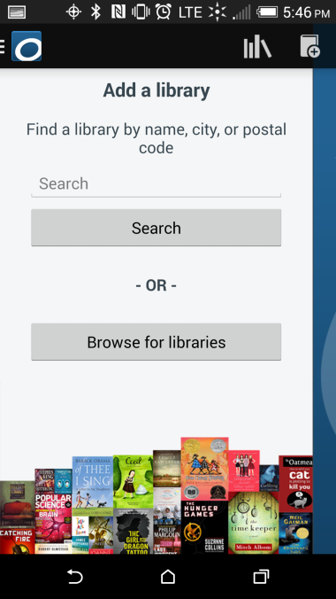
Using the OverDrive App
Getting started with the
OverDrive App
In the search field, type the name of the town where you library is located and tap the Search button.
We are going to search for the library in Norristown.

Slide 21
Using the OverDrive App
Getting started with the
OverDrive App
A list of libraries in and near your town may display
Scroll or swipe until you see your library. Then tap on it.
Ours was the only one on the list because it’s the only library in Norristown

Slide 22
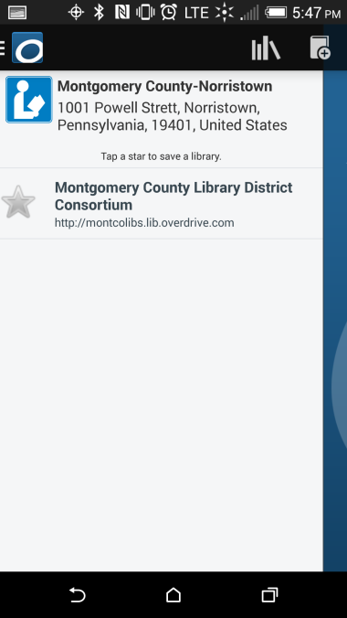
Using the OverDrive App
Getting started with the
OverDrive App
Tap on the star to add it to your library list. It will turn gold.
This library will remain in your libraries list, so you won’t have to search for it again later.

Slide 23
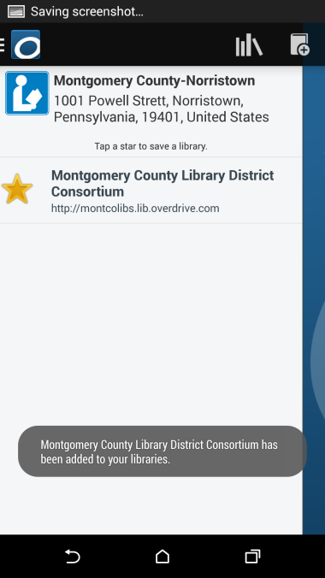
Using the OverDrive App
Getting started with the
OverDrive App
You will see confirmation that your library has been added to your Get Books list.
Then, tap the library name to be taken to the website that hosts the digital collection.

Slide 24
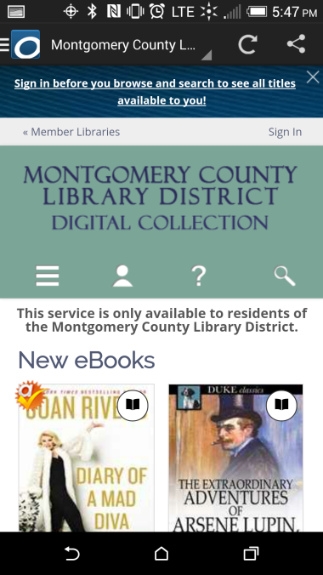
Using the OverDrive App
Getting started with the
OverDrive App
The website for the digital collection opens up in the OverDrive app.
Sign into the website before you start to search for eBooks.
Tap on the Sign in link

Slide 25
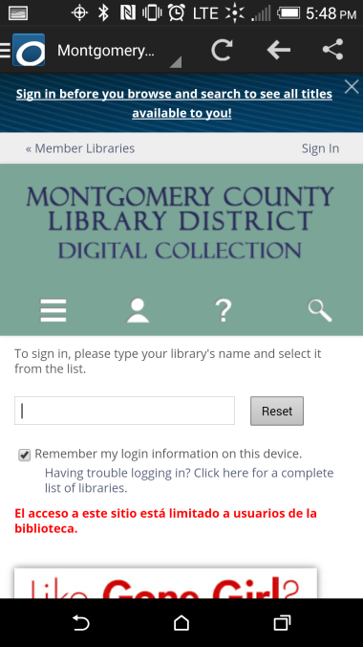
Using the OverDrive App
Getting started with the
OverDrive App
In the empty field, begin typing the name of your library, which in our case is Montgomery.

Slide 26
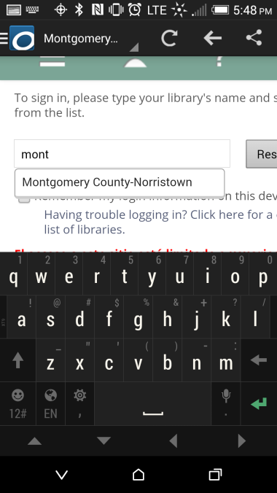
Using the OverDrive App
Getting started with the
OverDrive App
As soon as you begin typing, you should see a list of possible matches. Tap on your library name.

Slide 27
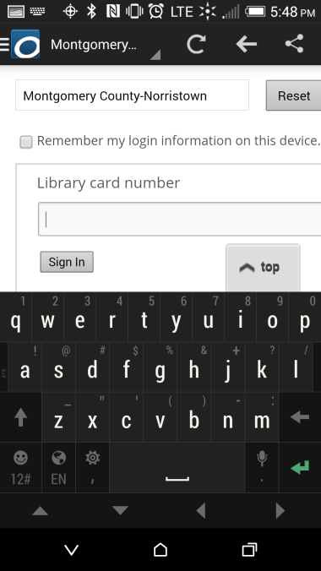
Using the OverDrive App
Getting started with the
OverDrive App
A new field will be displayed where you type in your library card number. After you type it in, tap the Sign In button.

Slide 28
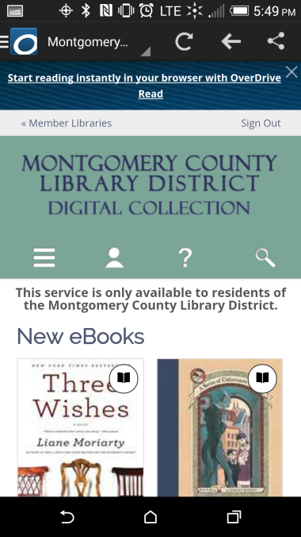
Finding and Borrowing a Library eBook
We are now back at the home page and ready to look for a book.
Our strategy right now is going to be to look for a book in the EPUB format (because that format is readable in our OverDrive app) by a certain author.
Tap on the magnifying glass on the webpage to bring up the search field

Slide 29
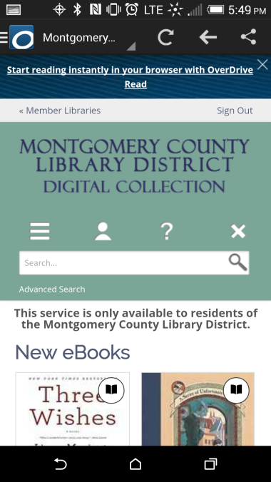
Finding and Borrowing a Library eBook
In order to conduct a search using parameters we need to use the Advanced Search function. We are going to try to find a book by Stephen King that is available for immediate download in EPUB format.
Tap on Advanced Search.

Slide 30
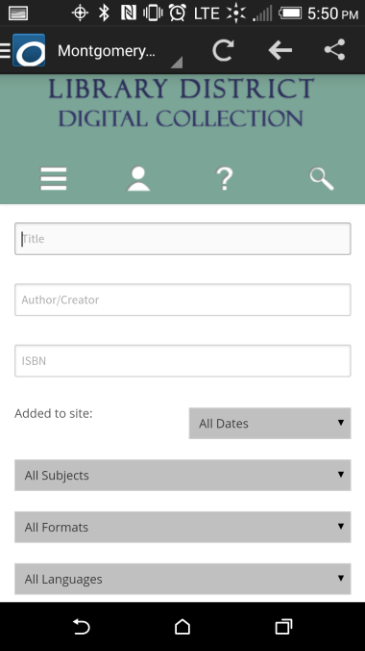
Finding and Borrowing a Library eBook
In the advanced search form, type “Stephen King” in the Author/Creator field.
Then tap on the All Formats menu

Slide 31
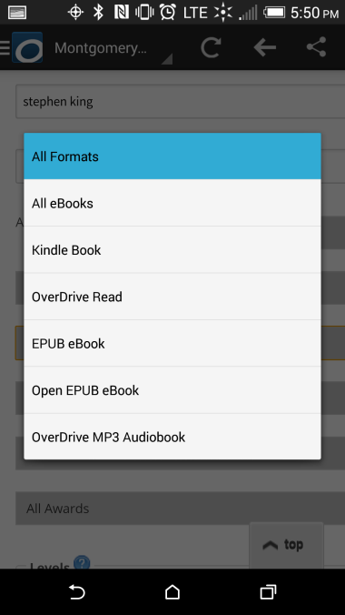
Finding and Borrowing a Library eBook
Most of the eBooks in the collection are in the EPUB format, and the OverDrive app is ideal for reading EPUBs.
Therefore, we’re going to limit our search to the EPUB format. Tap on EPUB eBook.

Slide 32
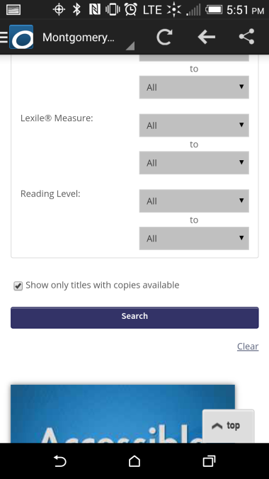
Finding and Borrowing a Library eBook
Next, tap into the checkbox next to Show only titles with copies available, and then tap Search

Slide 33
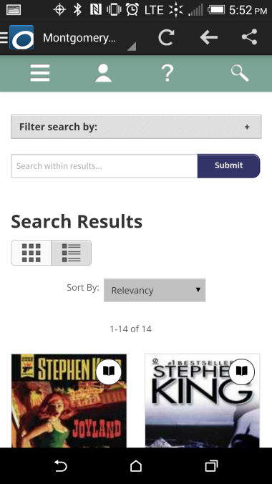
Finding and Borrowing a Library eBook
The Search results can be viewed in two different ways.
The Cover view shows only the Covers of books along with their title and author.

Slide 34
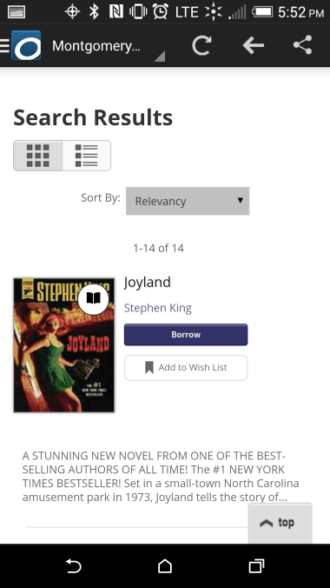
Finding and Borrowing a Library eBook
The List view gives you slightly different information and includes a Borrow button.
However, if you use the Borrow button, you won’t be able to choose a lending period. In order to choose a lending period you need to tap on the book cover.

Slide 35
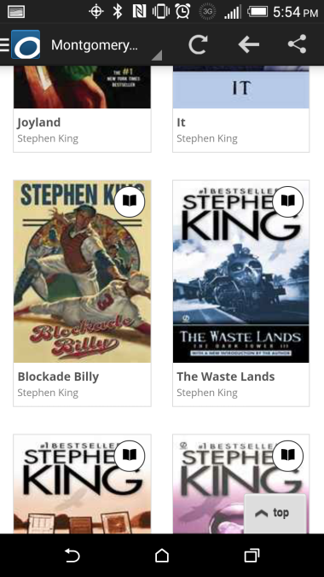
Finding and Borrowing a Library eBook
Back in the Cover view, we are scrolling through the results list and we decide to borrow Blockade Billy.
Tap on the cover of the book.

Slide 36
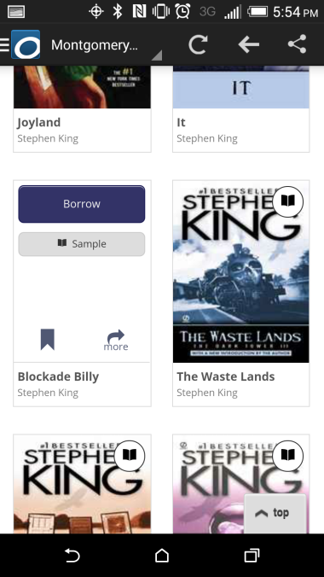
Finding and Borrowing a Library eBook
After you tap the cover, there are some quick options you can perform on the book. We want to see the page with all of the information pertaining to the book, so tap on the “more” button

Slide 37
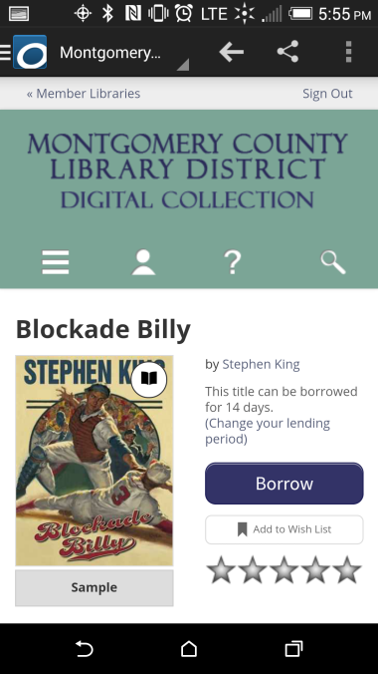
Finding and Borrowing a Library eBook
Note the Borrow button and the message underneath that says the title can be borrowed for 14 days.
This loan period draws from a setting in your account that applies to all digital loans.
The following screens show how to change this setting if you want the book for less or more time. We’ll start by tapping on “Change your lending period”

Slide 38
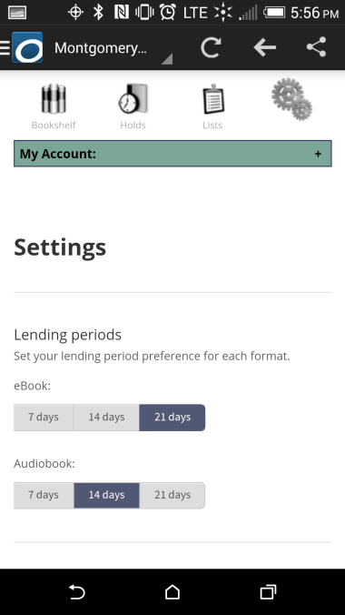
Finding and Borrowing a Library eBook
This screen is the account settings. Tap on the desired lending period for your eBooks. We going to change ours to 21 days.
Now tap the back button ONCE. Make sure to wait until the page loads. Tapping the back button twice exits the app, and you may have to start over again to get your book.

Slide 39
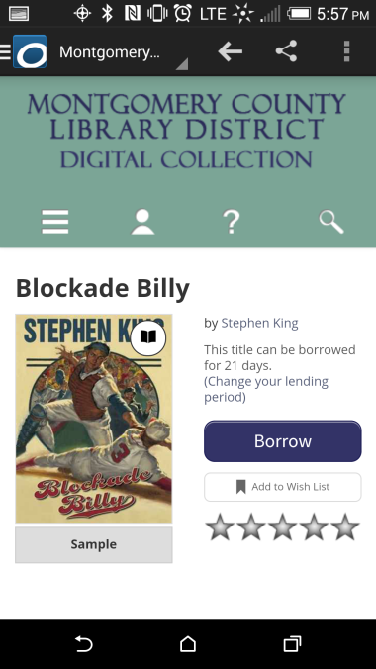
Finding and Borrowing a Library eBook
Back at the book, notice how the loan period has changed.
Be aware that the lending period will now be 21 days for every future book we borrow until we change the lending period again in our account settings.
Now tap the Borrow button

Slide 40
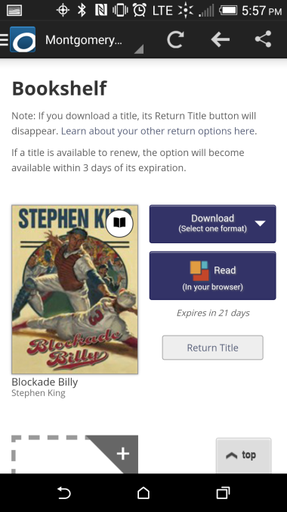
Finding and Borrowing a Library eBook
Once the book has been borrowed you will be brought to your OverDrive online Bookshelf where you will find the Download button.
If you have made a mistake or change your mind, you can return the item before you download it. Once you download an item, it can only be returned using the controls in the OverDrive app.

Slide 41
Finding and Borrowing a Library eBook
Some books just happen to be available only in EPUB format. In these cases, EPUB eBook is already listed on the download button.
Note that the download button for the Blockade Billy has a prompt to select a format. You would click on that drop-down arrow and select your format.

Slide 42
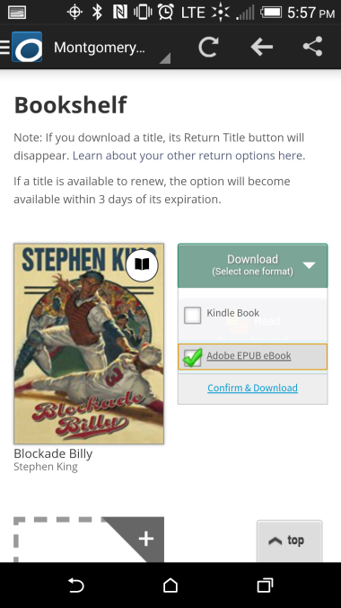
Finding and Borrowing a Library eBook
Make sure to select “Adobe EPUB eBook”. Once the format is selected from the drop-down menu, you would then click the Confirm & Download link. Bear in mind that once you click the Confirm & Download link, you will not have a chance to change the format. You will also only be able to return the book from the OverDrive app controls

Slide 43
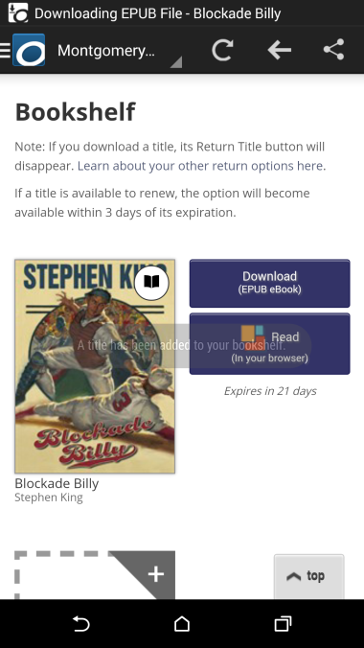
Finding and Borrowing a Library eBook
The download button for Blockade Billy shows that the ePub format was selected and the lack of a Return Title button indicates it has already been downloaded.
The download button remains on your online bookshelf because you can download your book up to three times to different devices that have the same OverDrive account.

Slide 44
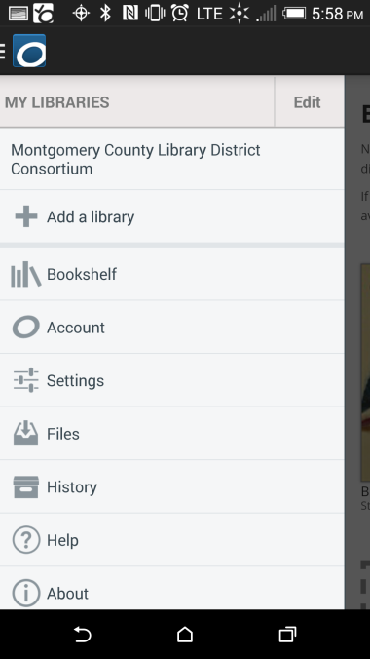
Finding and Borrowing a Library eBook
To read your book, tap on the menu button in the upper left and then tap Bookshelf.

Slide 45
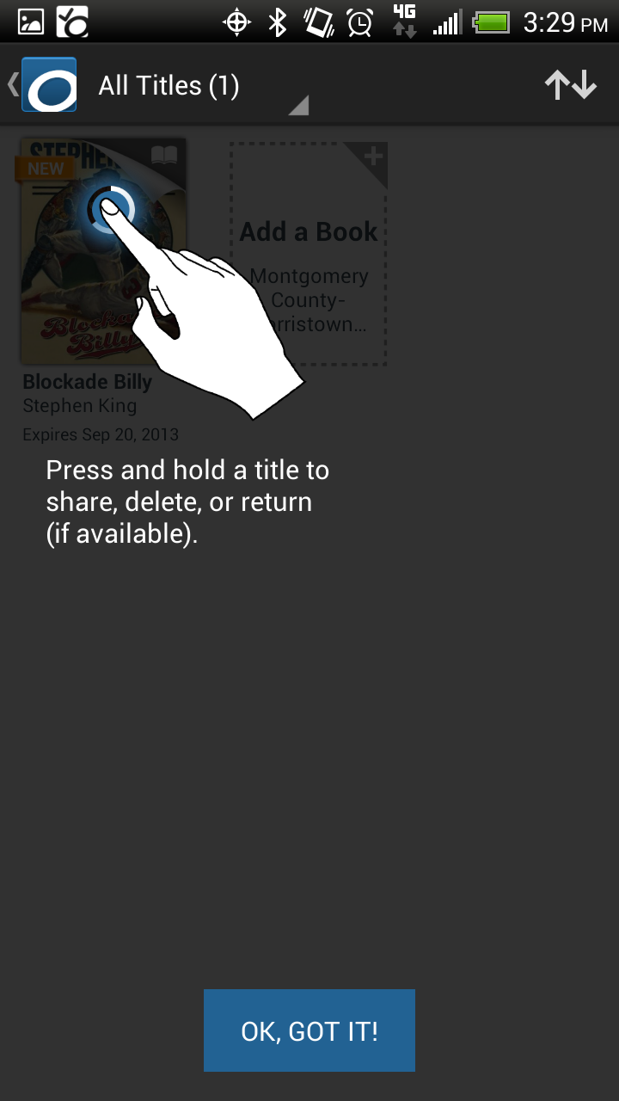
Finding and Borrowing a Library eBook
Another prompt may come up explaining how to manage books in your app’s bookshelf.
Tap OK to continue

Slide 46
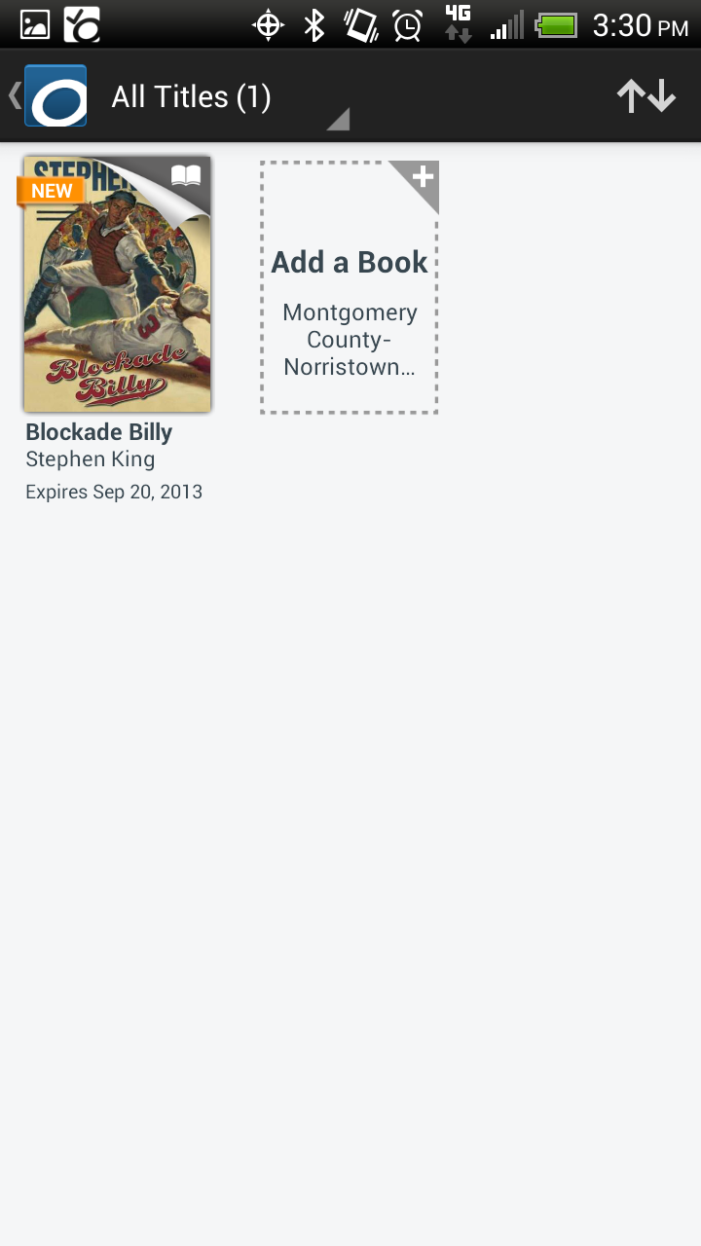
Finding and Borrowing a Library eBook
On your Bookshelf, you can you can tap on the book jacket to open it.

Slide 47
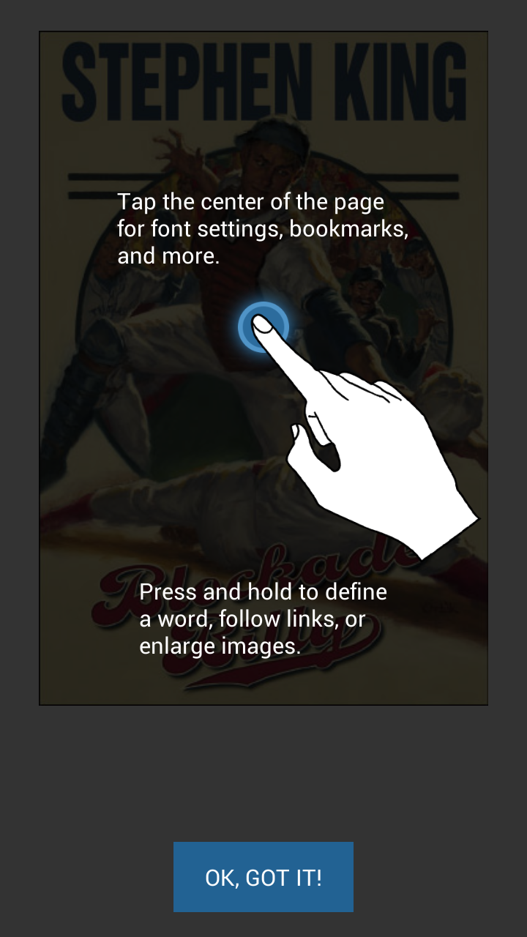
Managing Your eBooks
When you first open a book through OverDrive, a prompt will tell you how to use the controls while reading a book
Tap OK to continue

Slide 48
Managing Your eBooks
This is the cover of the book. Swipe right or left to navigate through pages

Slide 49
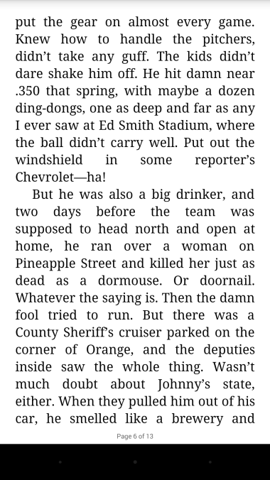
Managing Your eBooks
A page within the book. Tap the center of a page to bring up a series of options

Slide 50
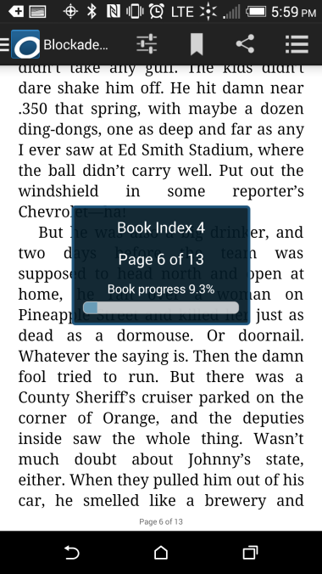
Managing Your eBooks
Here you can see the progress of the book. There may be a row of buttons on the bottom which would be your device’s system buttons that become hidden while reading. The top row of buttons to the right are options to change viewing options, as well as bookmarking, sharing options, and navigation.
Tap the button in the upper left to bring up your main menu again.

Slide 51
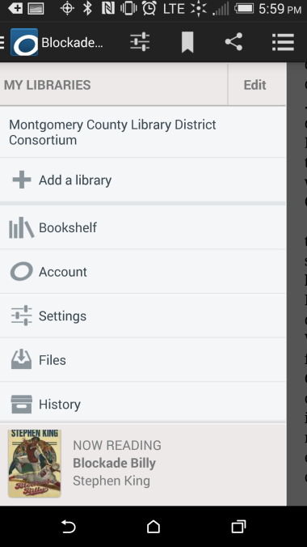
Managing Your eBooks
Tap the Bookshelf button to go back to the books saved on your device.

Slide 52
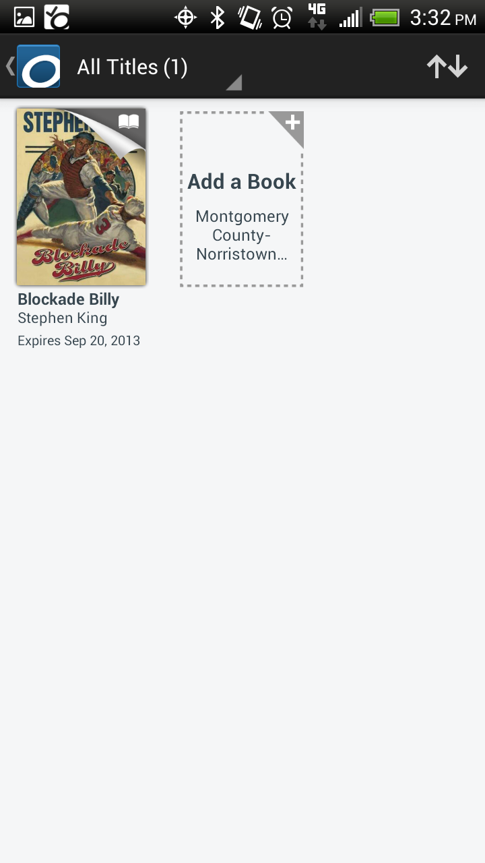
Managing Your eBooks
To return the book early, tap and hold the book you want to return

Slide 53
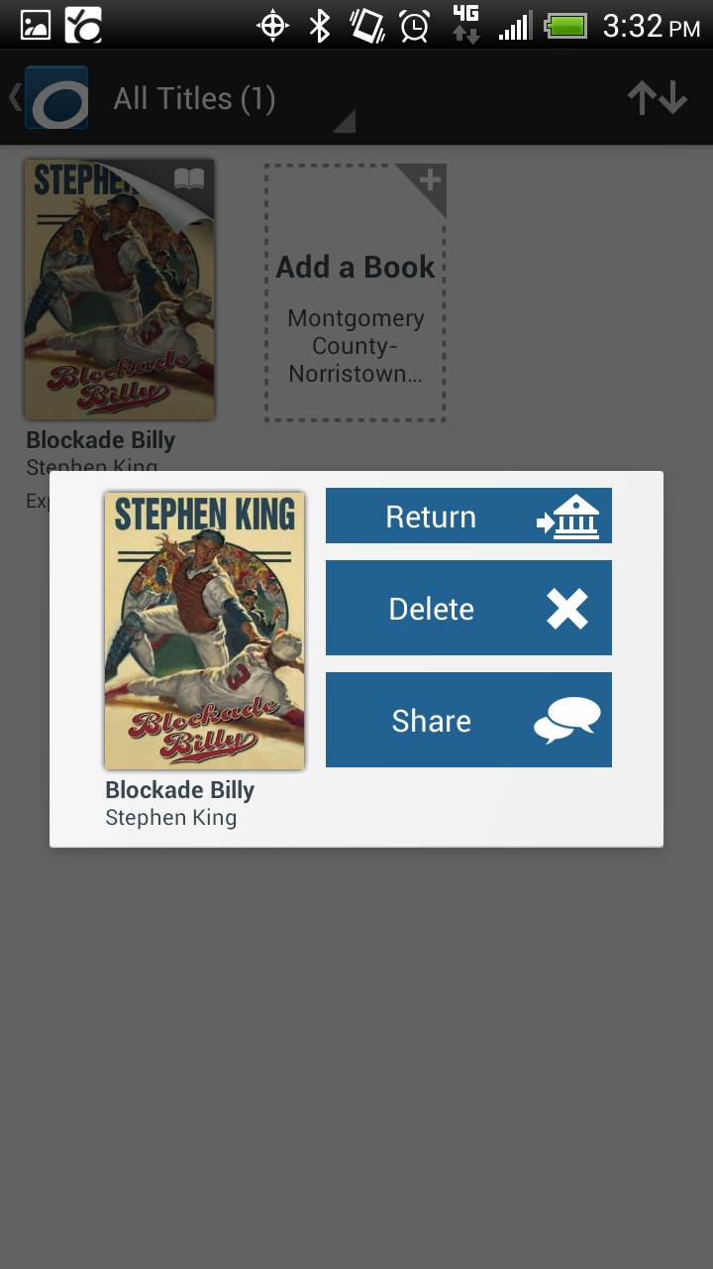
Managing Your eBooks
A prompt comes up
Tap Return

Slide 54
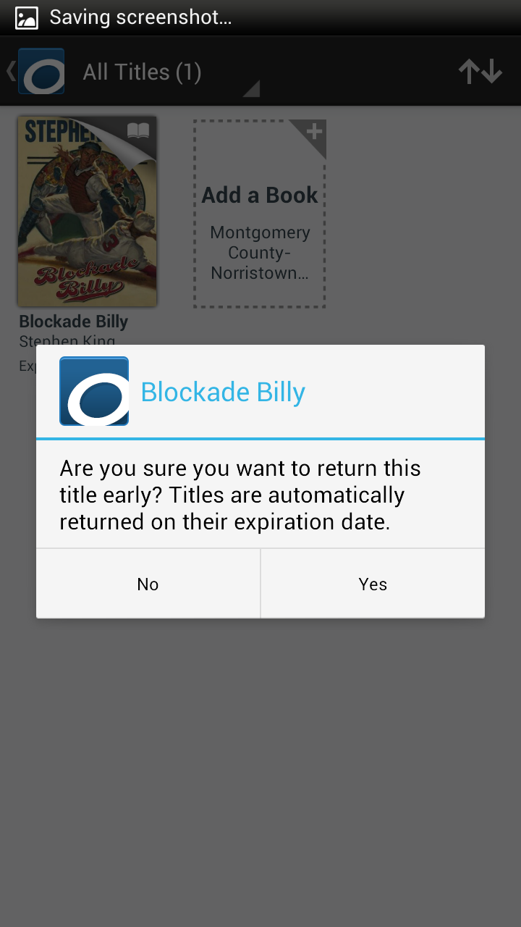
Managing Your eBooks
Tap Yes. This will return the book to the library, increasing books you can borrow on your account by one, and also deletes it from your device.

Slide 55
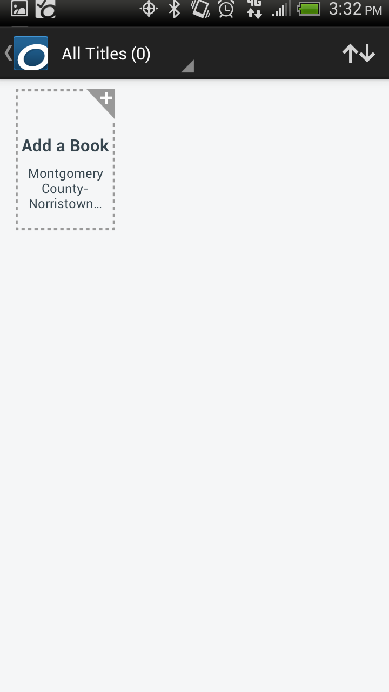
Managing Your eBooks
To download another book, tap on the Add a Book icon. This will automatically bring you to the homepage of your default library’s OverDrive site

